Slide 1

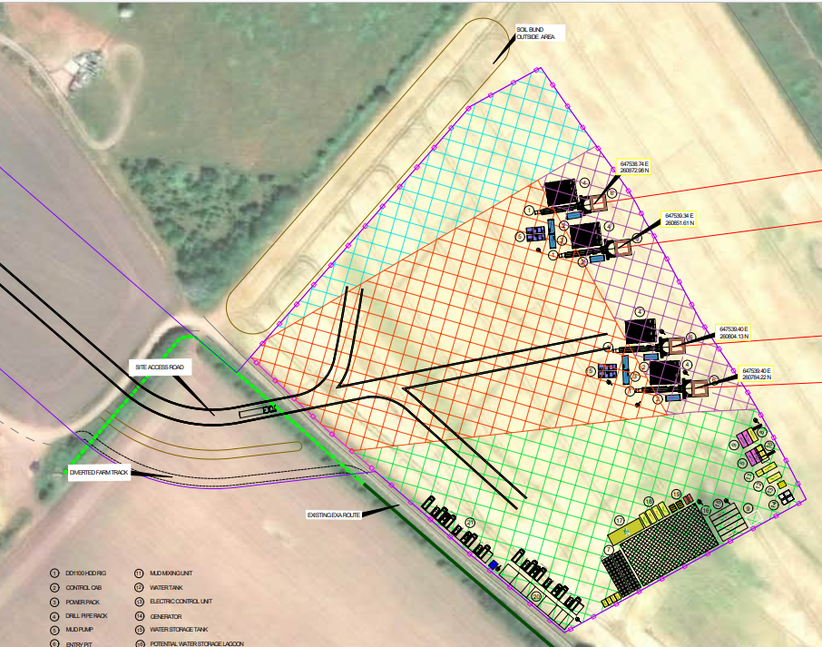
Landfall HDD Works
Indicative Landfall Construction Consolidation Site (CCS)
HDD Rig
Control Cab
Power Pack
Drill Pipe Rack
Mud Pump
Entry Pit
Mud Product Storage
Holding Tank
Waste Skips
Recycling Unit
Mud Mixing Unit
Water Tank
Electric Control Unit
Generator
Water Storage Tank
Potential Water Storage Lagoon
Storage
Workshop
Generator
Office and Welfare Facilities
Water Tank
*(non-exhaustive list)
TJB
TJB
TJB
TJB
Notes:
From EA2-ONC-CNS-PLN-IBR-000008 – RDD CoCP Main Text

